Slide 1
Week 9
Peer Assisted Learning

Slide 2
Today’s Session
Quickly Go Over Surveys & Minor Changes.
Then, we’ll quickly look at:
OOP in Python
Java Error Handling
Then rest of the session will focus on OOP programming exercises in Python.

Slide 3
Future Sessions
People thought the survey that went out on Sunday each week was not the best for getting ideas. We agree, so we’ll stop doing that for getting topic ideas.
From now, we’ll ask at the end of the session if there are any topics you want to cover in future sessions; at the end feel free to come up and give us ideas for topics.
More interactive sessions? - we’re open to suggestions ☺.

Slide 4
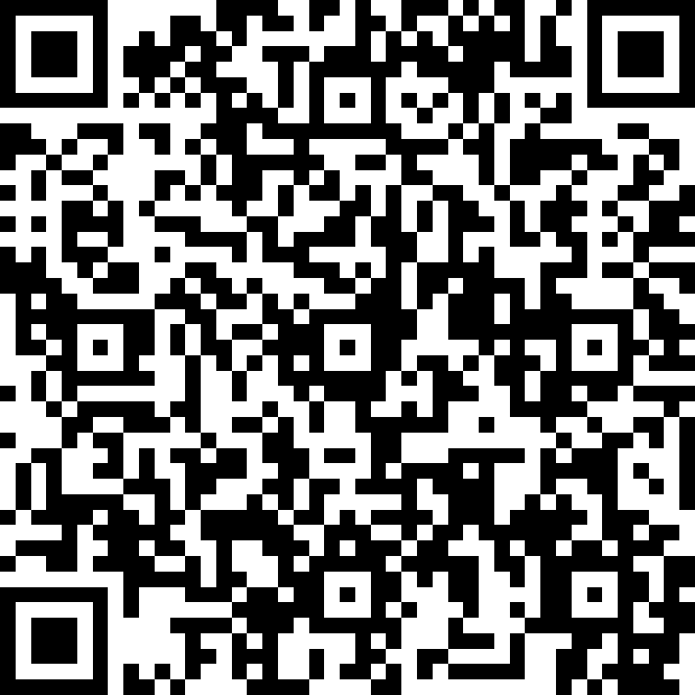
Quick Note: PAL Attendee Survey
Complete the survey to let us know about your PAL experience.
Students who complete the survey could win a £20 Amazon Voucher!
Please complete before 13 December.

Slide 5
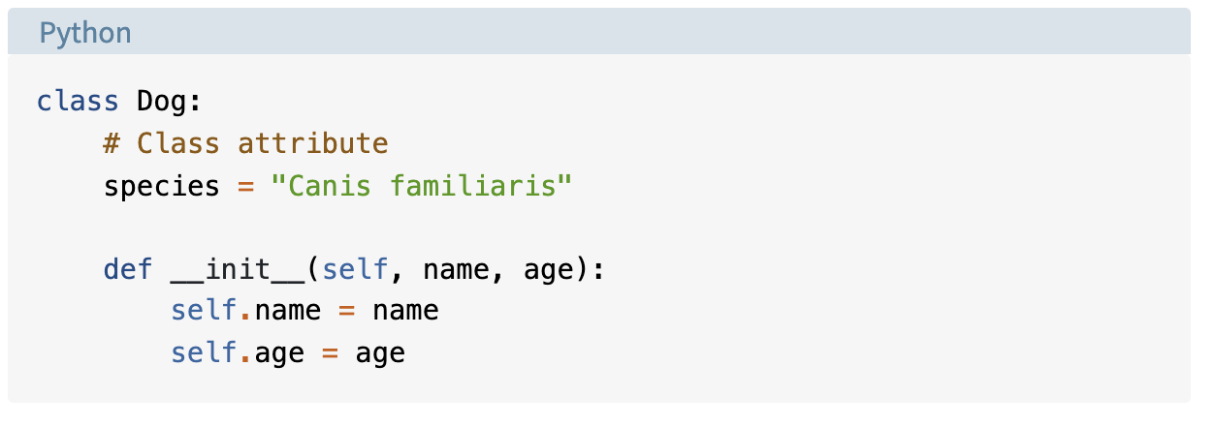
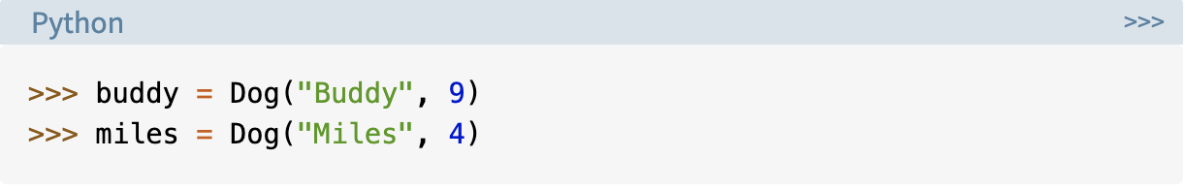
Defining a Class & Instantiating & Method
To the right, we have class attributes and instance attributes?
What is the difference?

Slide 6
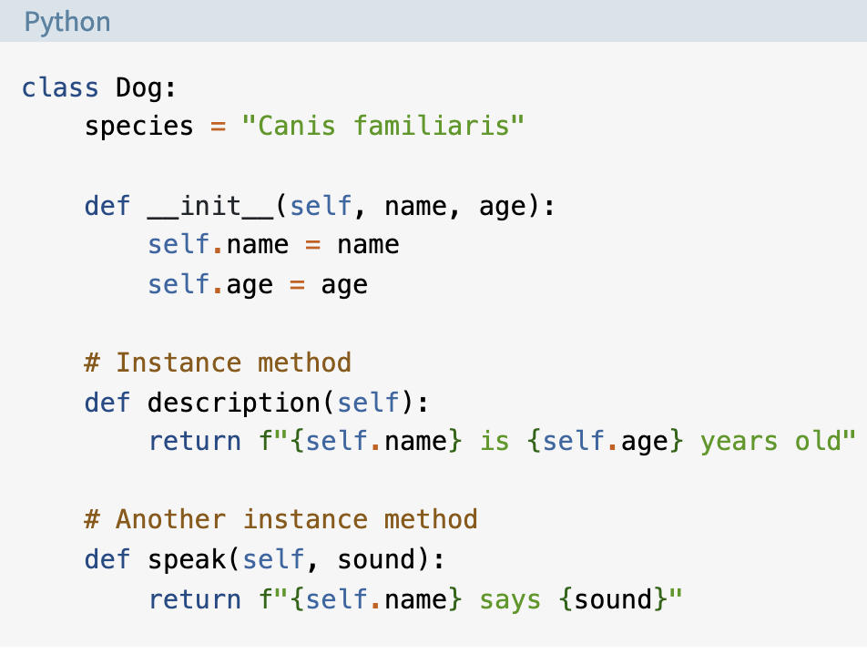
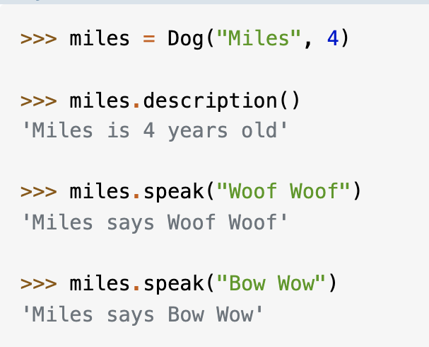
Instance Methods

Slide 7
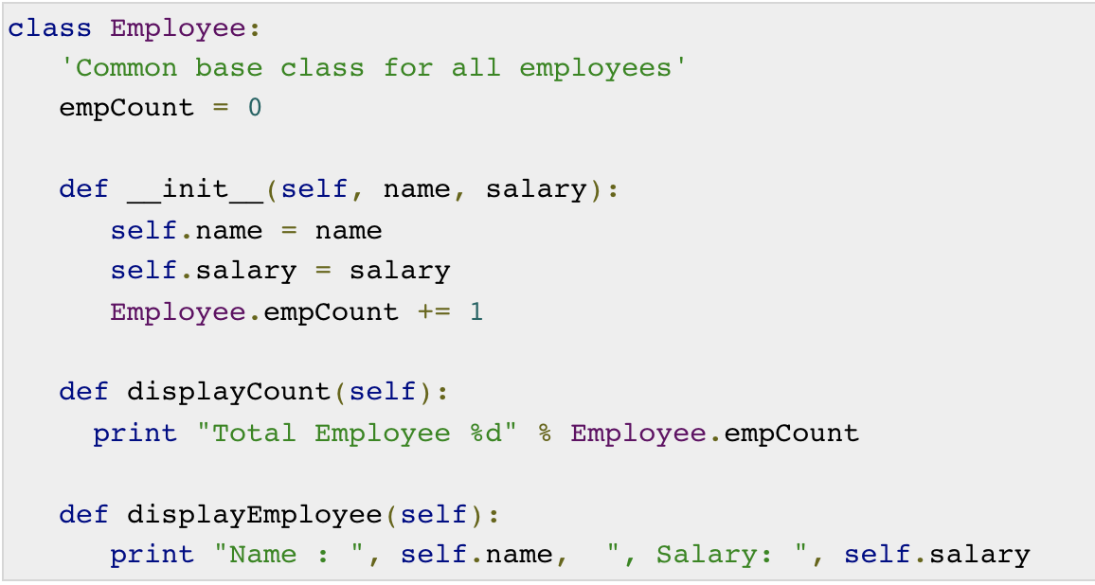
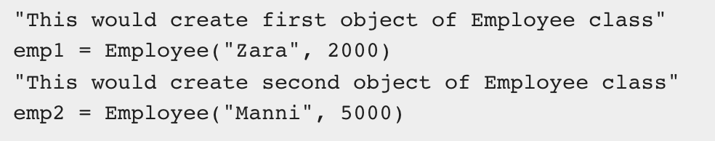
Another Example

Slide 8
Activity
OOP in Python:
Write a Python class named Circle constructed by a radius and two methods which will compute the area and the perimeter of a circle.
Create a deck of cards class. Internally, the deck of cards should use another class, a card class. Your requirements are:
The Deck class should have a deal method to deal a single card from the deck
After a card is dealt, it is removed from the deck.
There should be a shuffle method which makes sure the deck of cards has all 52 cards and then rearranges them randomly.
The Card class should have a suit (Hearts, Diamonds, Clubs, Spades) and a value (A,2,3,4,5,6,7,8,9,10,J,Q,K)

Slide 9
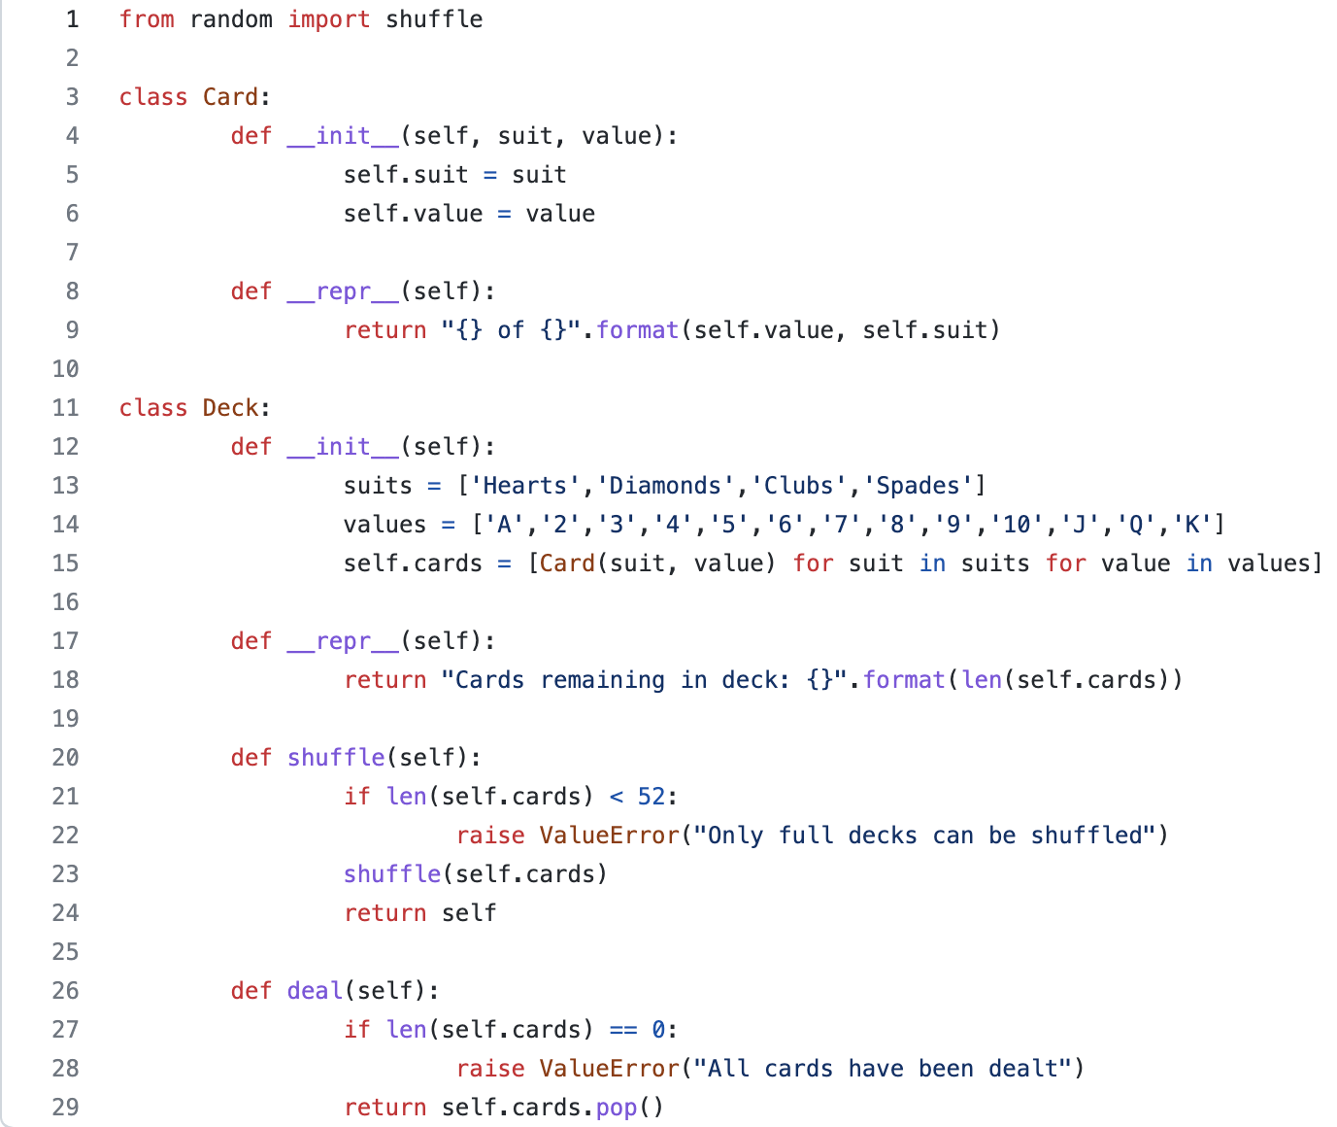
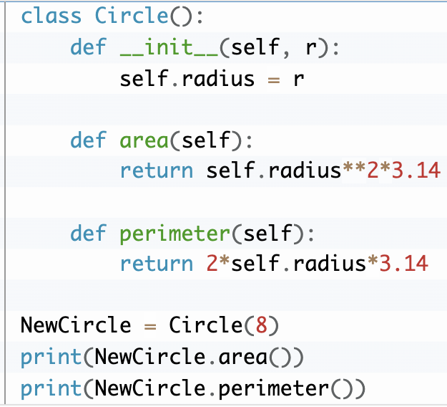
Answers

Slide 10
Kahoot

